Slide 2
YOUR NAME
Please specify your name below
Arevik Arakelyan

Slide 3
iOS

Slide 4
#1
XCODE / SOURCE CODE

Slide 5
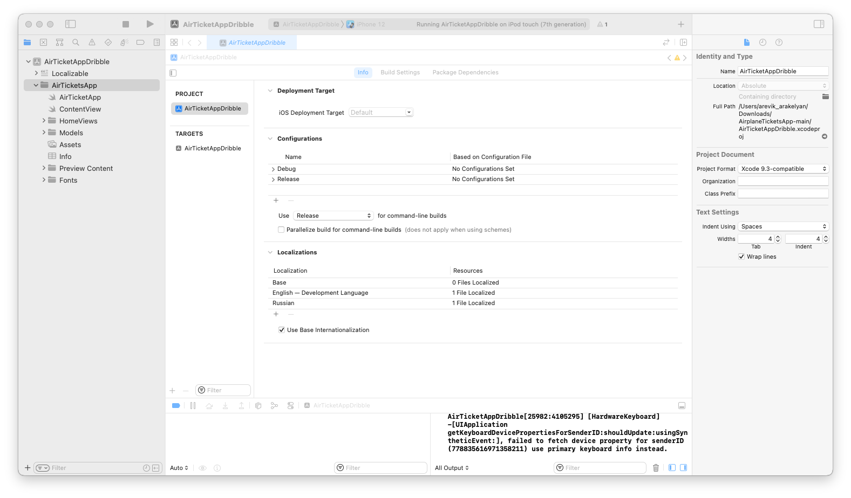
iOS #1.1
Download the Project using the link from notes.
Extract files from ZIP archive. Open in Xcode.
Notes:
https://tiny.one/ios-task

Slide 6
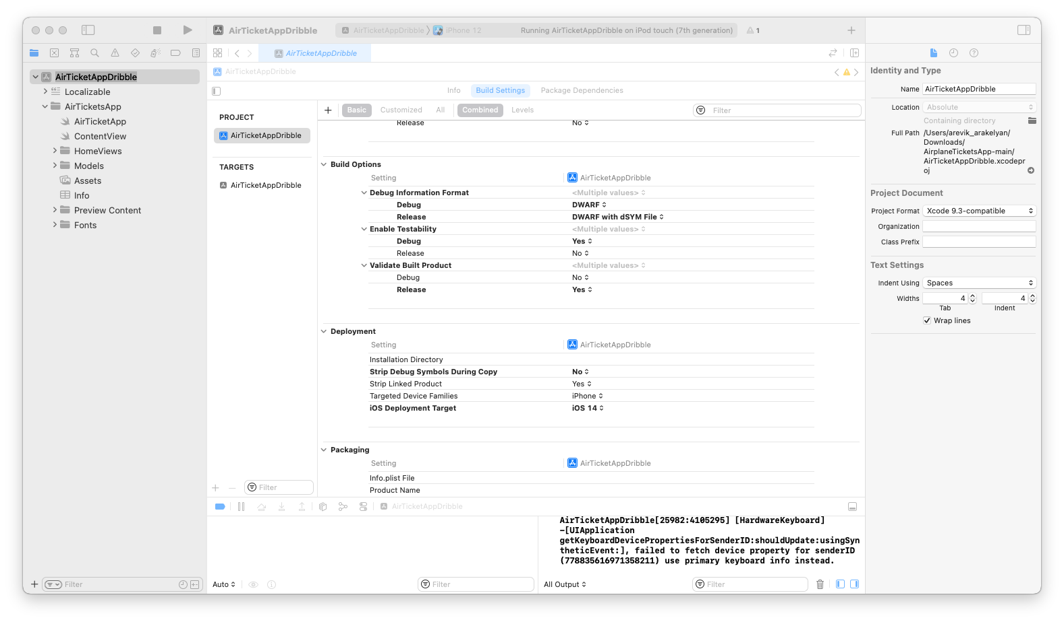

iOS #1.2
Find following info on Xcode regarding the app:
App Type: iPhone/iPad/Universal

Slide 7
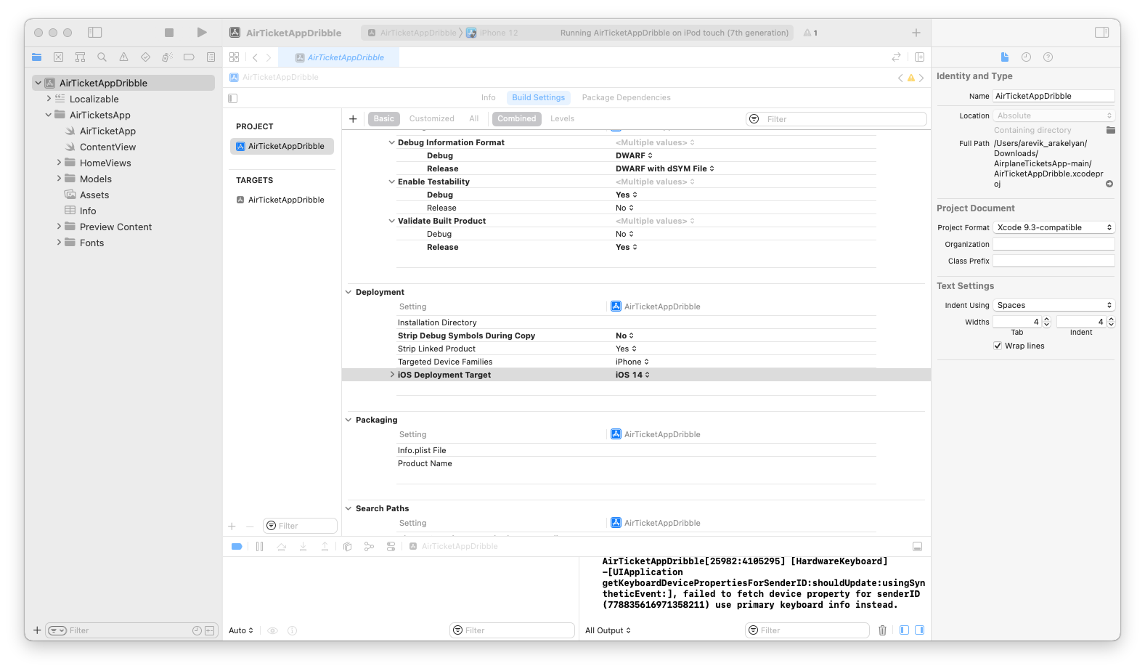
iOS #1.3
Find following info on Xcode regarding the app:
Target OS version

Slide 8
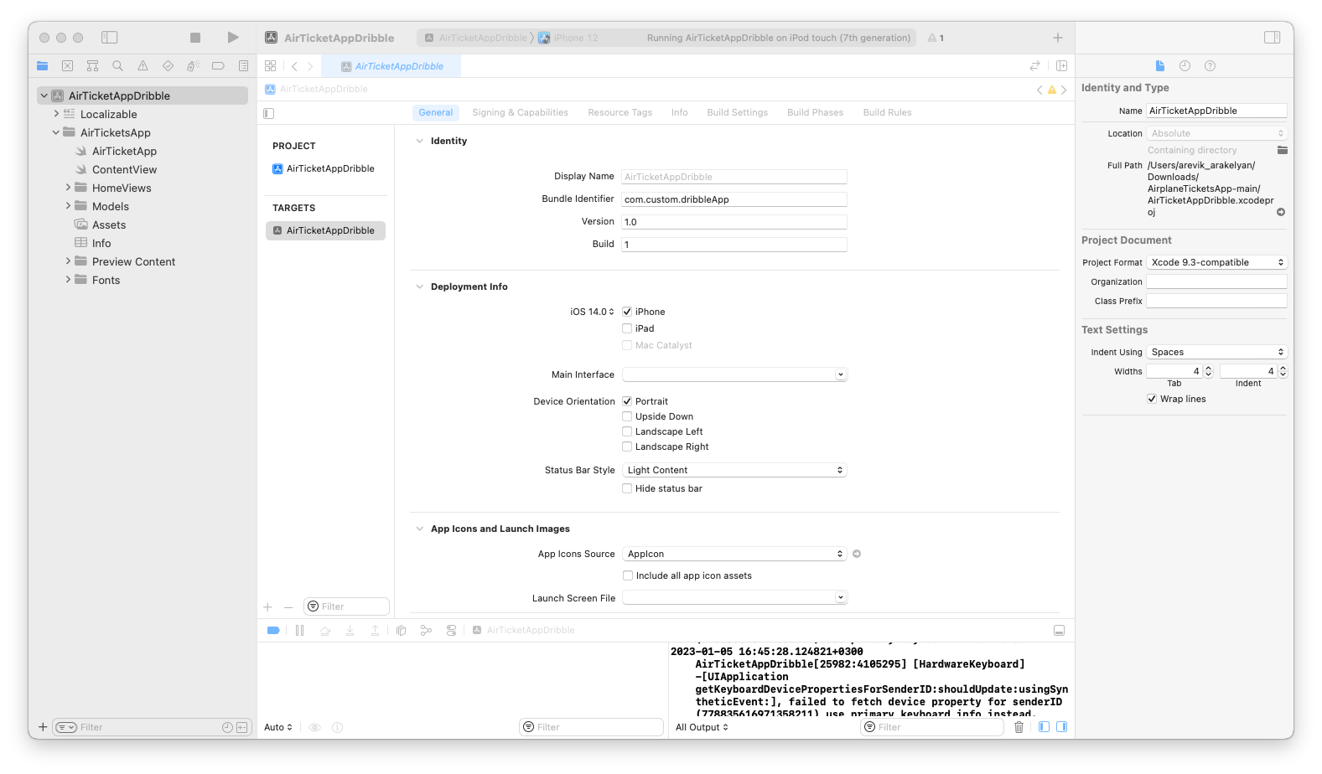

iOS #1.4
Find following info on Xcode regarding the app:
Supported Screen Orientation

Slide 9
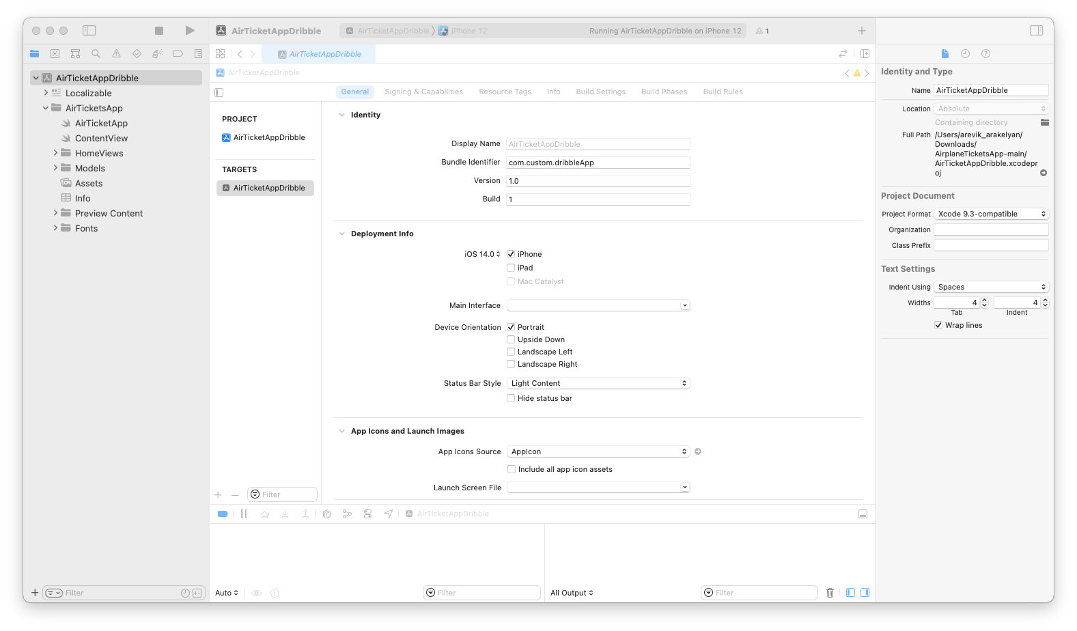
iOS #1.5
Find following info on Xcode regarding the app:
Bundle ID

Slide 10
#2
XCODE / SIMULATOR

Slide 11
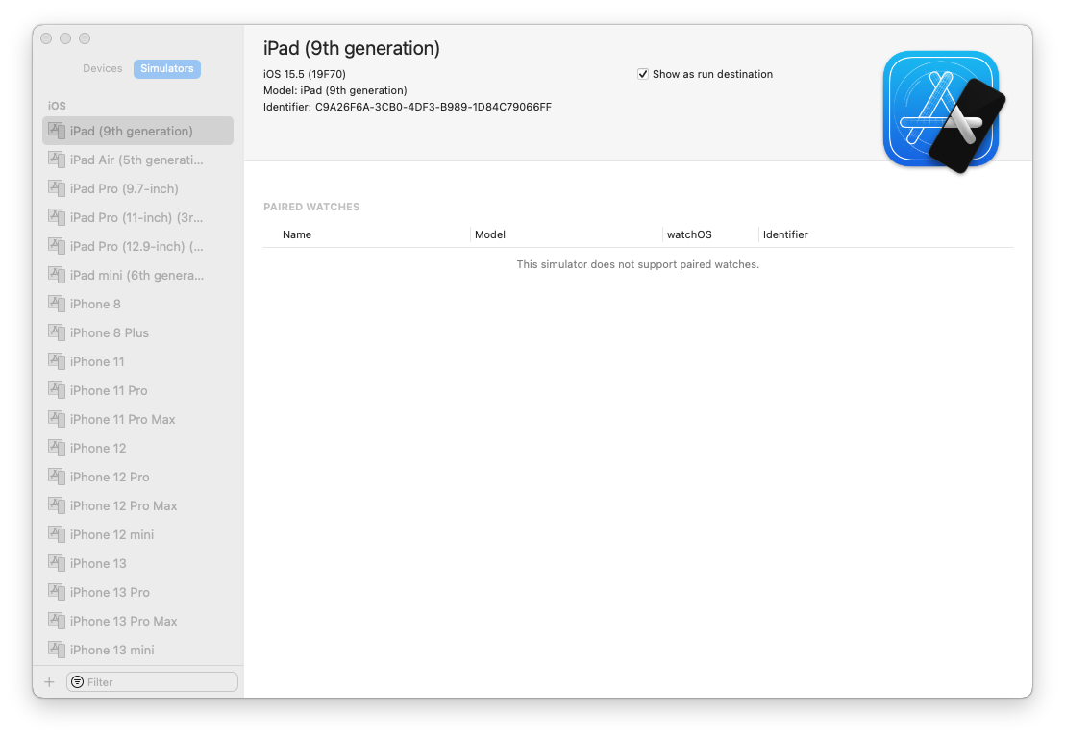
iOS #2.1
Open place where you can add/create Simulators

Slide 12

iOS #2.2
Create one more Simulator with your name

Slide 13


iOS #2.3
Run another Simulator with ‘iPhone X’-like design

Slide 14
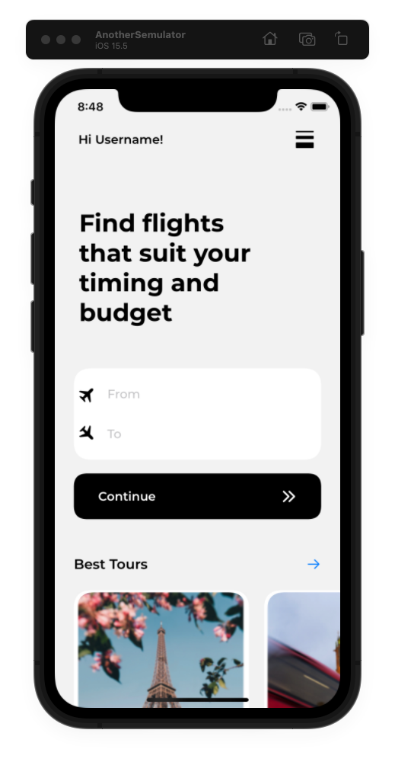

iOS #2.4
Run Project on just created Simulator.

Slide 15
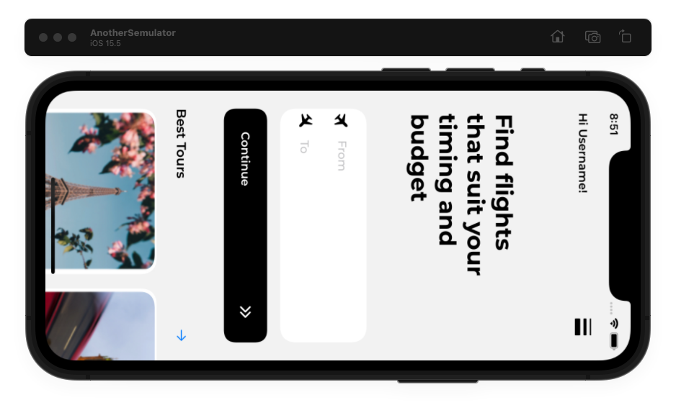

iOS #2.5
Rotate Device

Slide 16
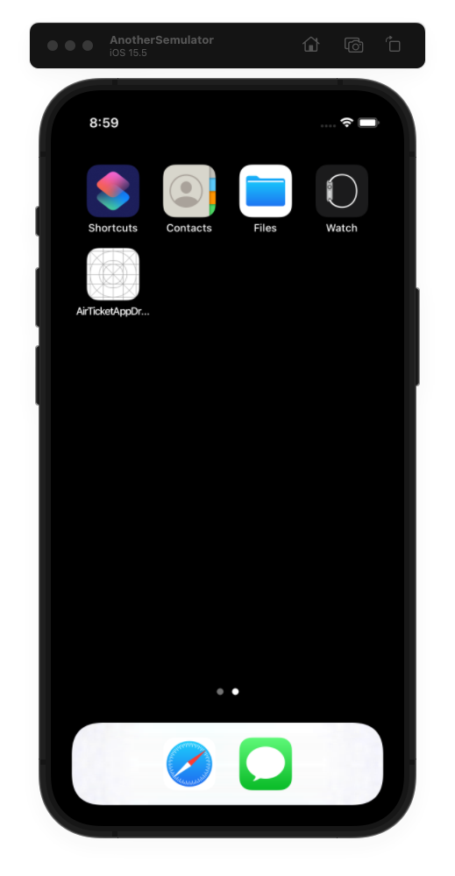
iOS #2.6
Show Device Springboard (Home Screen)

Slide 17
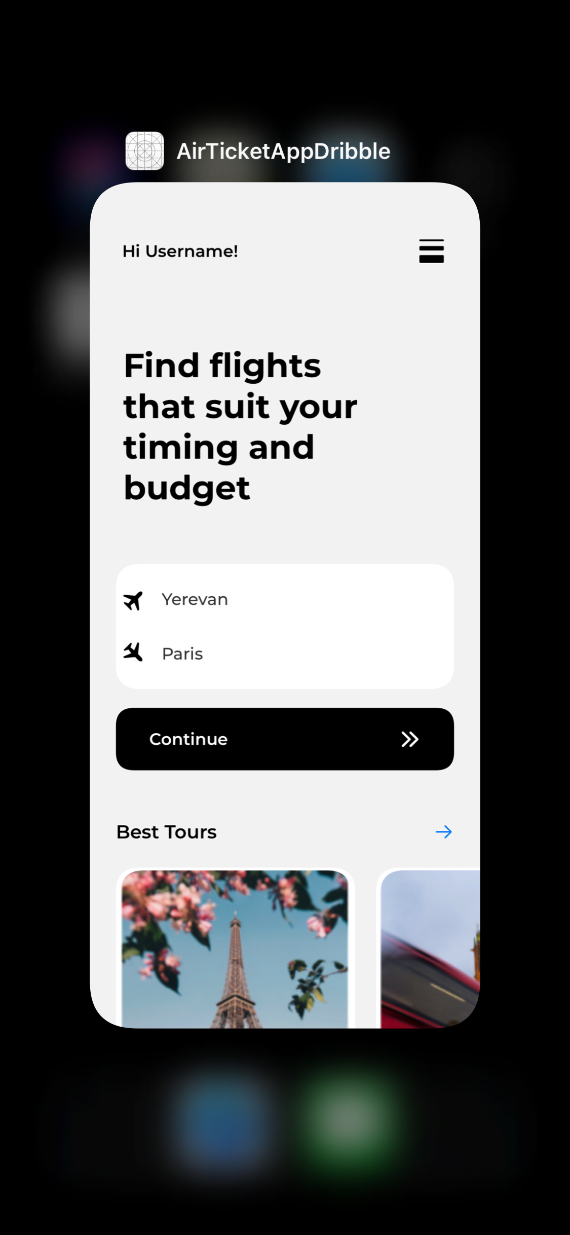
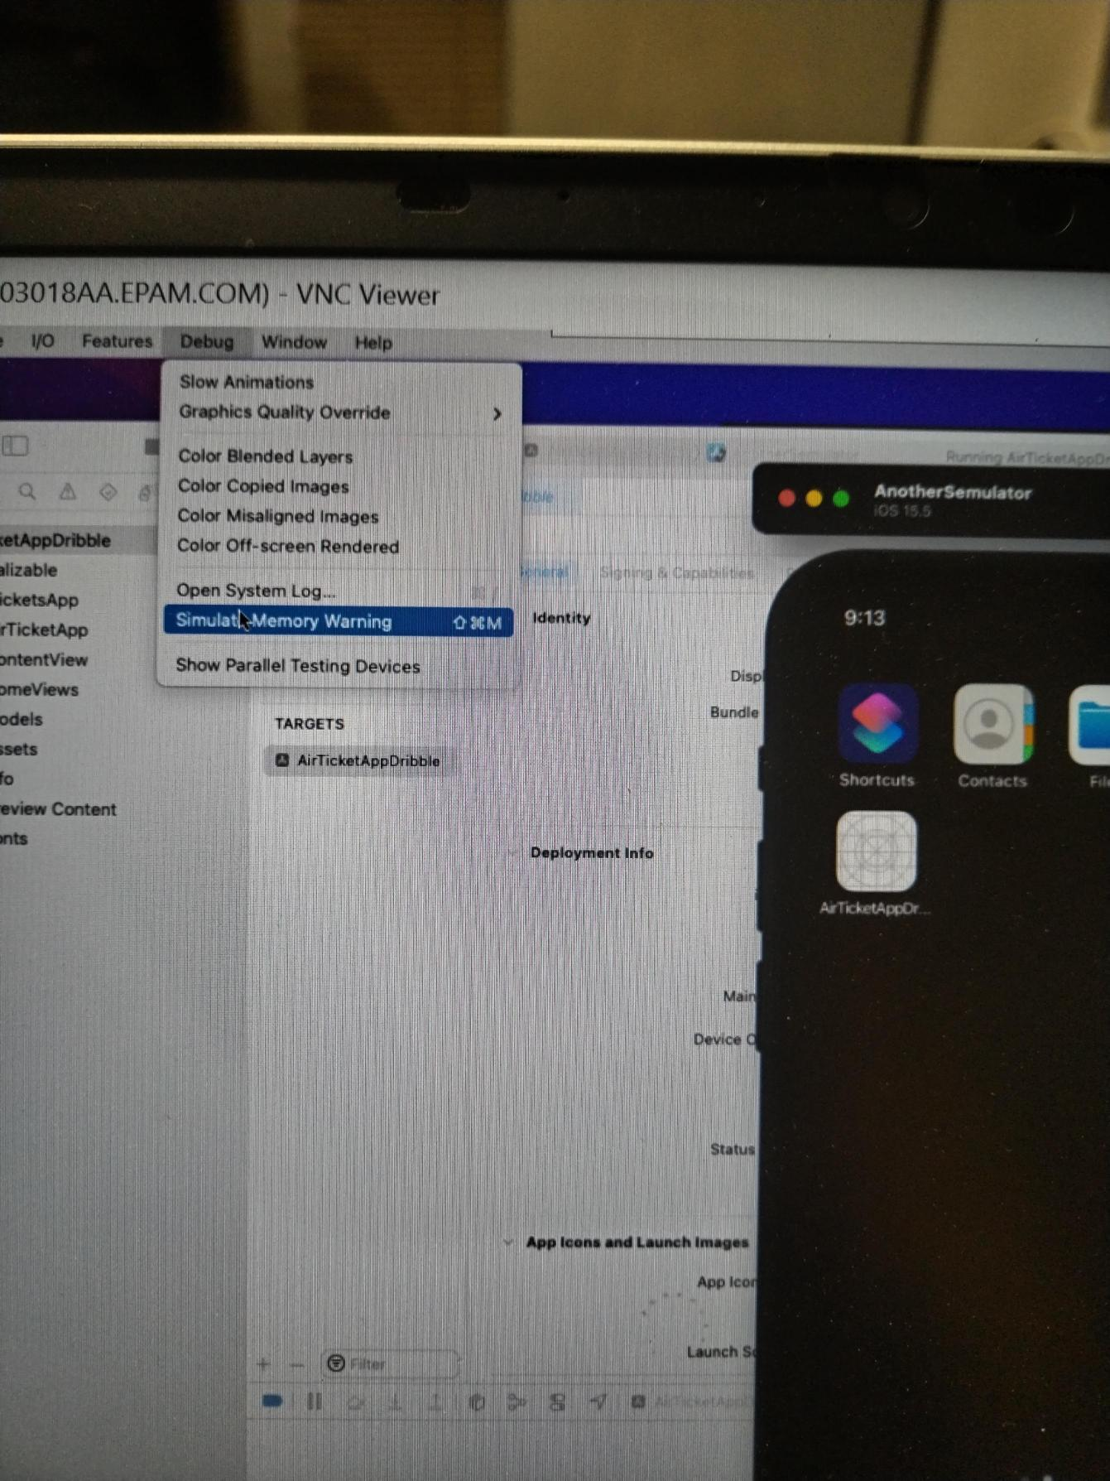
iOS #2.7
Show iOS App Switcher View

Slide 18
iOS #2.8
Working with Simulator: Simulate Memory Warning
(add screenshot that displays place to do it)
Notes:
It was impossible to make screenshot, so I take a photo

Slide 19
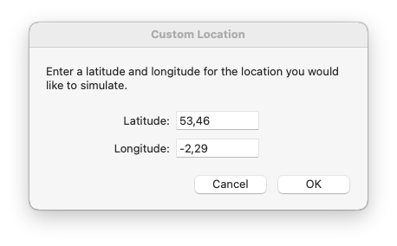

iOS #2.9
Working with Simulator: Set Location (show the place where to set)
Latitude: 53.46
Longitude: -2.29. / or You can open Maps & show current location / Note that you won’t see changes on remote macOS (due to security reasons)

Slide 20
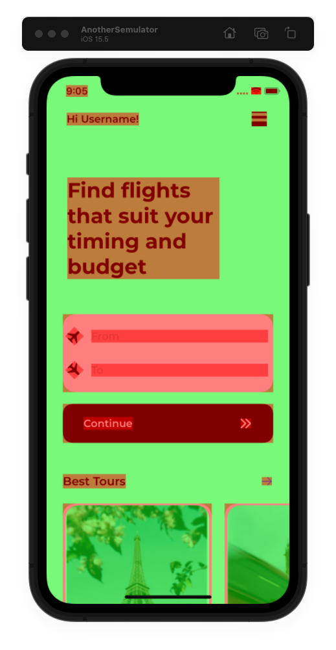
iOS #2.10
Enable ‘Color Blended Layers’

Slide 21

iOS #2.11
Describe Gestures.
Way(s) to emulate
- two fingers zoom (in/ out)
WHICH KEY IS USING what to press on keyboard to emulate this gesture
.You can move the two gray circles by holding Option and Shift and moving the mouse. • Or by holding Option and moving the mouse (mac m1) Command ++ increase text size Command +- decrease text size
play the video above

Slide 22
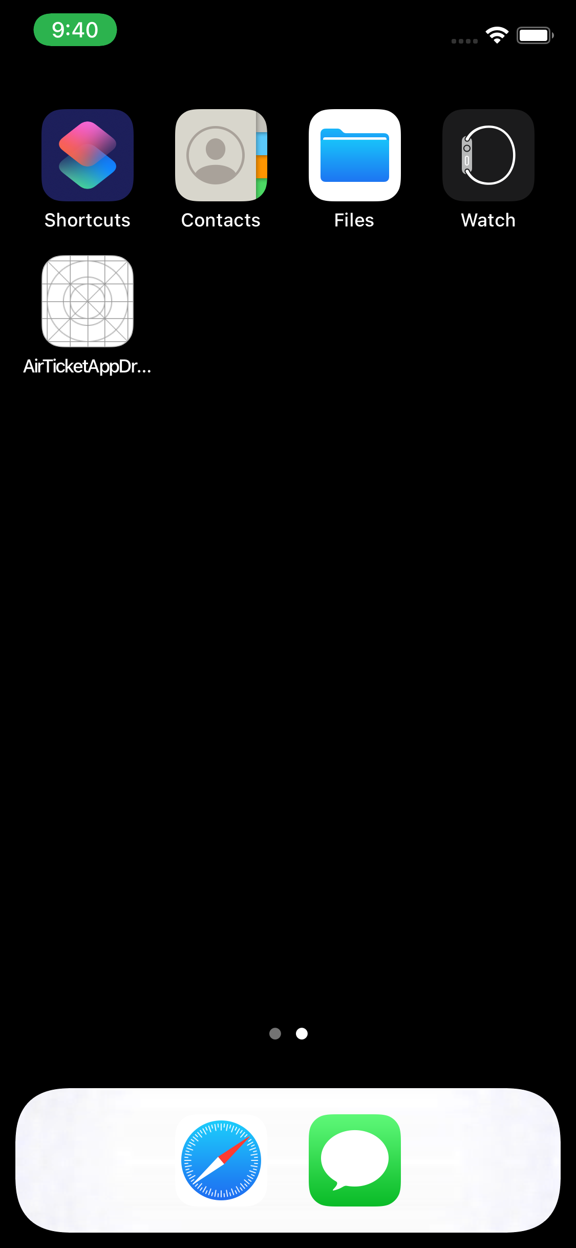
iOS #2.12
Working with Simulator: Emulate Incoming Call that is in progress

Slide 23
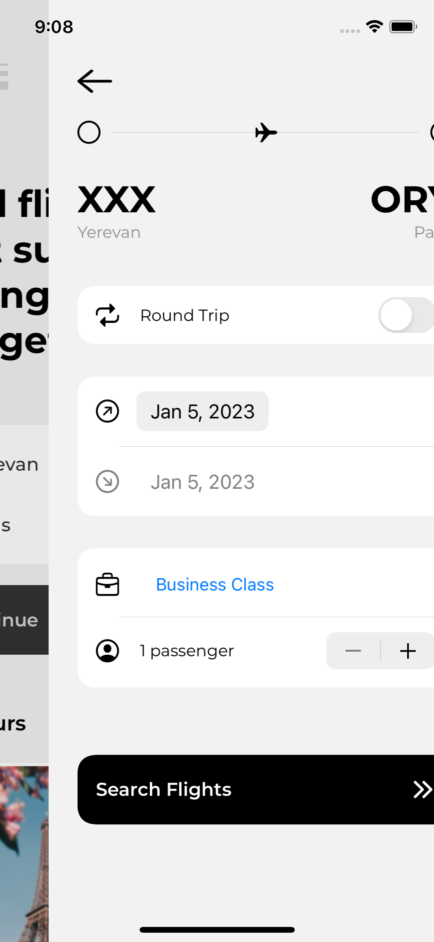
iOS #2.13
Working with Simulator: Enable Slow Animation

Slide 24
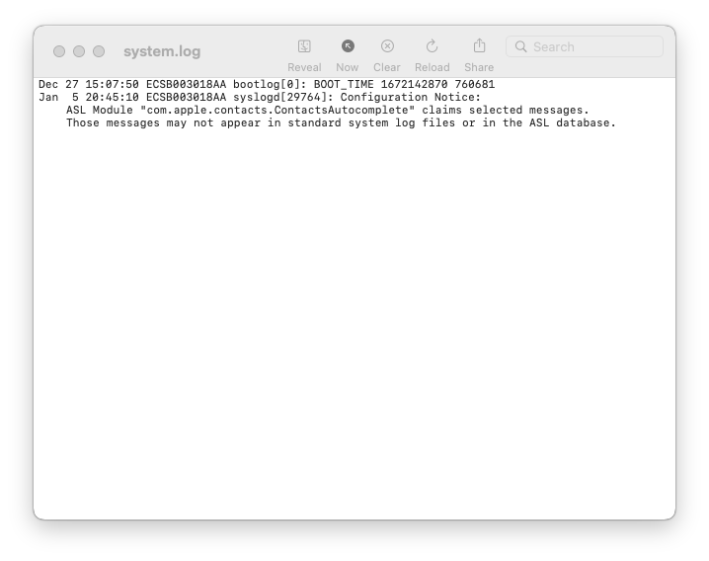
iOS #2.14
Show real-time log (in Xcode)

Slide 25
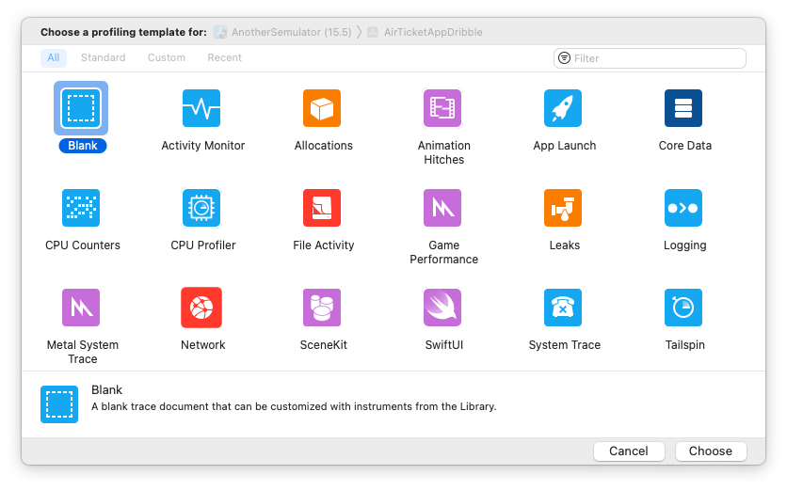
iOS #2 (optional)
Place in iOS where to see all installed Profiles

Slide 26
ANY COMMENTS?

Slide 27
FEEDBACK FORM
Feel free to share any notes for me in case of any ☺. Some ideas:
What was the most difficult?
How much time did you spend for tasks? …
It was also great job, like Android, very interesting. I used virtual MacOS first. It was good experience for me.
Only one negative size, virtual MacOS was worked slow
Thank you!

